Slide 1
Delivering the Dude: Continuous X
DR Brent Pabst
brentpabst.com
@brentpabst

Slide 2
About Brent
Dude Solutions
Enterprise Architect
203 Solutions
Principal, Founder
Wake Technical Community College
Adjunct Faculty

Slide 3
The Basics
Continuous Integration
Continuous integration (CI) is the practice, in software engineering, of merging all developer working copies to a shared mainline several times a day.
Continuous Delivery
Continuous Delivery (CD) is a software engineering approach in which teams produce software in short cycles, ensuring that the software can be reliably released at any time.

Slide 4
Common Challenges
Horizontal and vertical growth and scale limitations
Mean Time to Deploy (MTTD) – measured in weeks/months
Deployments tightly-coupled to development process
Tools are overburdened or complex or non-existent

Slide 5
About the Dude
SaaS-based Enterprise Asset Management firm in Cary, NC
Founded in 1999
Still running code from 1999 in production today (see: Tech Debt)
Growing like crazy!!!

Slide 6

Our Challenges
Complexity abounds
Software
Processes
Tools – or lack thereof
Lack of deployment confidence: 20% at best
Large-scale organizational growth: 30 – 40% annually

Slide 7
Ye Olde Process
Code
Write Code
Write Tests?
Build
Make sure it compiles
Deploy
XCopy Files
Manual promotion

Slide 8
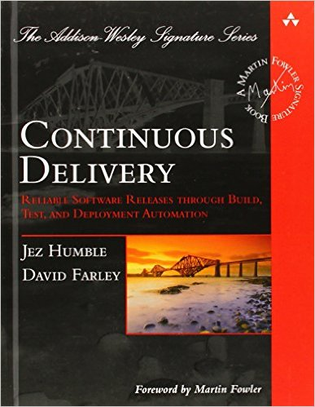
Our Solution: Continuous X
New…
Processes
Tools
Automate… everything
Quality First
High-level of iteration
DEVOPS!!!

Slide 9
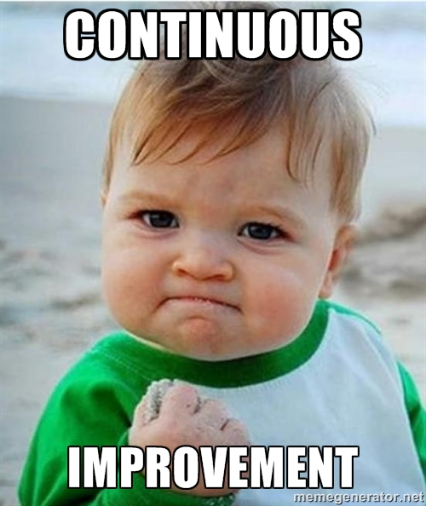
Why Continuous X?
CI/CD has become a prescribed checklist
You must build continuous improvement into the process
Version 1 is not the same as version 100
Don’t accept the status quo

Slide 10









How Ours Works…
Share Dev Packages
Write Code
Git Flow
Build & Test
Deploy
Serve

Slide 11
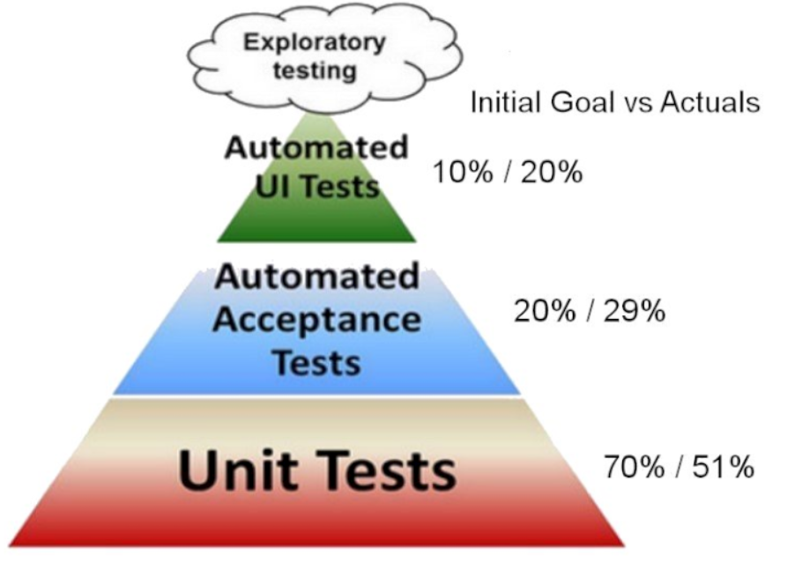
Quality First!
3,693 total automated tests
10,701 potential test runs per day
Note: The percentages are derived from the total number of tests. Not coverage.

Slide 12
Build & Deploy?
Hey Octopus!
Hey TeamCity!
Here’s a deployment package
Got it! Thanks.
Can you deploy that package to dev?
Sure, hang on!
OK!
OK, all done.
Sweet! I’ll test it.
OK, Tests Passed/Failed
Good, I’ve updated the release

Slide 13
<Demo>

Slide 14
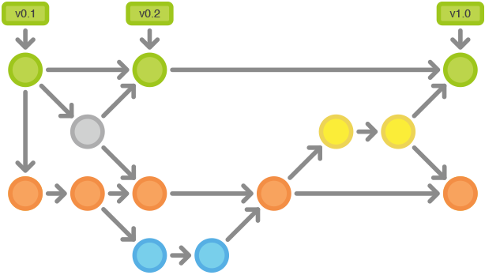
What’s Next…
Code to Production: reduce time from commit to client
Git branching with self-provisioning environments all the way to production
Docker || Cloud Foundry???
Empowered developers with DevOps support

Slide 15
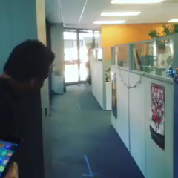
We’re Hiring!!!
#JoinTheDude
All Engineering Positions:
Software, Quality, DevOps
Dude Solutions booth in the lobby!

Slide 16
Delivering the Dude: Continuous X
DR Brent Pabst
brentpabst.com
@brentpabst
github.com/brentpabst/ncdevcon16

